Slide 1

Retrieval Augmented Generation (RAG)

Slide 2
Why is domain knowledge needed?
Conversational agents needs to have a wide knowledge.
Sometimes generic knowledge alone is not enough to have a conversation.
For example, imagine we are having a conversation about rules and Regulations of a particular university.
Generic Information and guidelines given by government might not be useful here.
Each university would have extended upon the guidelines and would have their own guidelines.
It becomes essential to have the domain knowledge to answer these questions naturally.
Thus, we need the domain knowledge for many scenarios

Slide 3
Problems with LLM
Large language models like GPT, Gemini and Llama demonstrate impressive performance in a variety of NLP tasks.
large language models also exhibit numerous shortcomings.
They fabricate facts.
They lack knowledge when dealing with specific domains and highly specialized queries.
Blindly using a black-box LLM may not suffice for production.
Traditionally, neural networks adapt to specific domains or proprietary information by fine-tuning models to parameterize knowledge

Slide 4
Parameterized knowledge
Parametric knowledge – Knowledge stored in the parameters of models.
They are acquired through training.
They are stored in the form of weight matrices of the neural network.
These represent the model’s understanding and generalization of the training data forming foundations for the responses.
Non – Parametric knowledge – External stored knowledge in form of tables, collections, graphs and indices.

Slide 5
Purely relying on the parameterized knowledge of LLMs is not beneficial for the following reasons:
The knowledge is not properly organized we don’t know where the information we need is stored
In fact, we don’t know if the information we are seeking is available in the parameters.
The knowledge stored in parameters will be generic due to the pre-training strategy we are using.
We want our LLM to be generalized across tasks and domains.
Only by fine-tuning we can achieve the domain expertise we are looking for.
But fine-tuning can only guarantee expertise in a handful of domains beyond that fine-tuning is not useful.
Hence, We go for Retrieval Augmented Generation

Slide 6
Retrieval augmented Generation
Let us understand how humans solve problems.
Humans don’t memorize all the knowledge in the world.
We simply search for relevant knowledge required for solving a problems among books, Internet etc.
We use the knowledge to solve the problem.
Retrieval Augmented Generation is very similar to this.
We feed external knowledge to LLMs to answer questions in real time.
Retrieval-Augmented Generation (RAG) refers to the retrieval of relevant information from external knowledge bases before answering questions with LLMs

Slide 7
History of RAG
To address the limitations of purely parameterized models, language models can adopt a semi-parameterized approach by integrating a non-parameterized corpus with parameterized models.
This approach is known as Retrieval Augmented Generation (RAG)
RAG existed before the advent of LLMs, but it became very popular only after the advent of LLMs
Initially it combined a pretrained retriever with a pre-trained seq2seq model (generator) and undergoes end-to-end fine-tuning to capture knowledge in a more interpretable and modular way
Dense retrievals on the retrieval side, such as the use of vector-based Dense Passage Retrieval (DPR)and training smaller models on the generation side are common practices.

Slide 8
Due to the overall smaller parameter size, both the retriever and generator often undergo synchronized end-to-end training or finetuning.
After the emergence of LLM like ChatGPT, generative language models became predominant, showcasing impressive performance.
Introducing RAG into large models’ In-Context Learning (ICL) can alleviate the aforementioned issues.
During the inference process, RAG dynamically retrieves information from external knowledge sources, using the retrieved data as references to organize answers.

Slide 9
Components of RAG
RAG system consists of two key stages:
Retrieval Phase:Utilizing encoding models to retrieve relevant documents based on questions, such as BM25, DPR, ColBERT, and similar approaches.
Generation Phase: Using the retrieved context as a condition, the system generates text.
RAG is akin to providing a textbook to the model, allowing it to retrieve information based on specific queries.
RAG is not suitable for teaching the model to understand broad domains or learn new languages, formats, or styles.

Slide 10
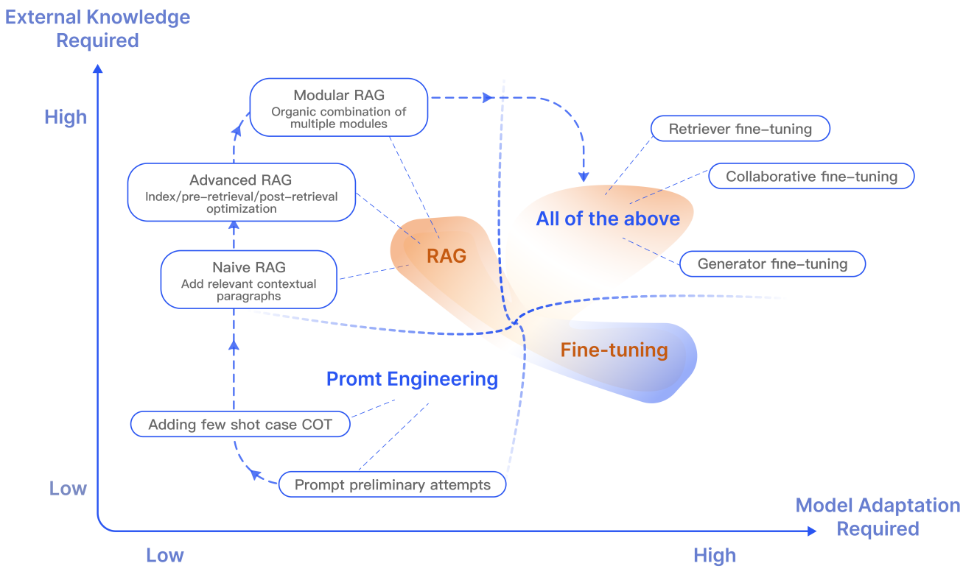

Slide 11
Advantages of using Rag
Reduces hallucination issues in language models.
Retrieval techniques allows the identification of the latest information.
Transparency is an advantage of RAG. By citing sources, users can verify the accuracy of the answers.
RAG has customization capabilities. Models can be tailored to different domains by indexing relevant corpora.
RAG is more scalable. It can handle large-scale datasets without the need to update all parameters.

Slide 12
Types of RAG
We categorize RAG into three types:
Naive RAG
Advanced RAG
Modular RAG

Slide 13
Naive RAG
Naive RAG was the earliest methodology
Gained popularity after Chat GPT was introduced
The naive RAG involves traditional process:
Indexing
Retrieval
Generation
Naive RAG is also summarized as a “Retrieve”-“Read” framework

Slide 14
Indexing
Obtaining data from the source and building an index.
Occurs offline.
Construction of a data index involves the following steps:
Data Indexing:
Cleaning and extracting the original data, converting different file formats such as PDF, HTML, Word, Markdown, etc., into plain text.
Chunking:
Dividing the loaded text into smaller chunks.
Chunk size impacts the context being fed to the model.
Embedding and Creating Index:
Process of encoding text into vectors through a language model.
The embedding models require a high inference speed.
Next step is to create an index, storing the original corpus chunks and embedding in the form of key-value pairs.

Slide 15
Retrieval
Given a user’s input, the same encoding model as in the first stage is used to convert the query into a vector.
The similarity between the question embedding and the embedding of the document blocks in the corpus is calculated.
The top K document blocks are chosen as the augmented context information for the current question based on the level of similarity.

Slide 16
Generation
The given question and related documents are combined into a new prompt.
The large language model is then tasked with answering the question based on the provided information.
Control what is generated by the LLM via Prompt templates.
We can deem the LLM to generate responses in a particular style too.
If there is historical dialogue information, it can also be merged into the prompt for multi-round dialogues.

Slide 17
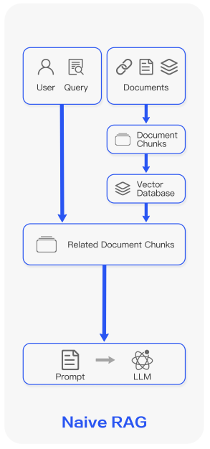

Slide 18
Drawbacks of Naive RAG
Not all blocks within the retrieval set correlate with the query.
A secondary issue is low recall, which arises when not all relevant blocks are retrieved.
Model can still fabricate an answer that doesn’t exist in the context.
Model can generate an answer that fails to address the query.
Toxicity or bias in the retrieved context, prompts the model to generate a harmful or offensive response.
Generation models may overly rely on augmented information, resulting in output that merely repeats the retrieved content.

Slide 19
Advanced RAG
Advanced RAG has made targeted improvements to overcome the deficiencies of Naive RAG
Advanced RAG incorporates preretrieval and post-retrieval methods.
Optimized indexing through methods such as sliding window, fine-grained segmentation, and metadata.
Various methods to optimize the retrieval and generation process.
Advanced RAG can be adjusted either through a pipeline or in an end-to-end manner

Slide 20
Pre-Retrieval Process
Optimizing Data Indexing :
The purpose of optimizing data indexing is to enhance the quality of indexed content
there are five main strategies employed:
Enhancing Data Granularity:
Removing irrelevant information and special characters.
Eliminating duplicate or redundant information.
Adding another layer of context with domain-specific annotations.(Like current domain of conversation).
Update the same continuously.

Slide 21
2. Optimizing Index Structures:
When constructing a RAG system, the chunk size is a key parameter.
Chunk size affects data fidelity. Llama index uses GPT-4 to evaluate the fidelity of various chunking methods.
a standalone index can be used to search, or filter based on metadata keywords, such as a specific “date” index
Can use Graph based Indexing . Using a graph data index can increase the relevance of the retrieval.
3. Adding Metadata Information:
Embed referenced metadata into chunks, such as dates and purposes used for filtering.
Filtering through metadata first can enhance efficiency and relevance.

Slide 22
4. Alignment Optimization:
Alignment issue : We compare a question with a document
Comparing a question with a question is more beneficial.
Alignment concept involves creating questions which are suitable to answer with each document.
Embedding (or replacing) these questions with the documents.
5. Mixed Retrieval:
The advantage of this strategy lies in leveraging the strengths of different retrieval technologies.
keyword-based search, semantic search, and vector search, adapts to different query types and information needs.

Slide 23
Embedding
Fine-tuning embedding:
The purpose of fine-tuning is to enhance the relevance between retrieved content and query
Adjusting embedding in domain-specific contexts and optimizing retrieval step.
Where questions and answers (document chunks) form fine-tuning pairs for the fine-tuning process. (Siamese architecture)
Dynamic embeddings:
use of dynamic embedding models such as BERT.

Slide 24
Post-Retrieval Process
After retrieving valuable context from the database, merging it with the query for input into LLM poses challenges.
may exceed the context window limit
lengthy retrieval prompt is ineffective, introducing noise and hindering the LLM’s focus on crucial information.
Additional processing of the retrieved content is necessary to address these issues.
ReRank:
Concept has been implemented in frameworks such as LlamaIndex, LangChain, and HayStack.
Diversity Ranker prioritizes reordering based on document diversity.
LostInTheMiddleRanker alternates placing the best document at the beginning and end.
CohereAI rerank bgererank5 , or LongLLMLingua recalculate the semantic similarity.

Slide 25
Post-Retrieval Process
2. Prompt Compression:
Noise in retrieved documents adversely affects RAG performance.
compressing irrelevant context, highlighting pivotal paragraphs, and reducing the overall context length.
Compress unwanted information (Summarization, Removing sentences with low perplexity etc.)

Slide 26
RAG Pipeline Optimization
The optimization of the retrieval process aims to enhance the efficiency and information quality of RAG systems
Hybrid Search:
blending various techniques such as keyword-based search, semantic search, and vector search
Recursive Retrieval and Query Engine:
Recursive retrieval entails acquiring smaller document blocks during the initial retrieval phase to capture key semantic meaning.
In the later stages of this process, larger blocks with more contextual information are provided to the language model (LM).
Step-Back-prompt:
Create a step-back question and answer the original question by answering the step-back question.

Slide 27
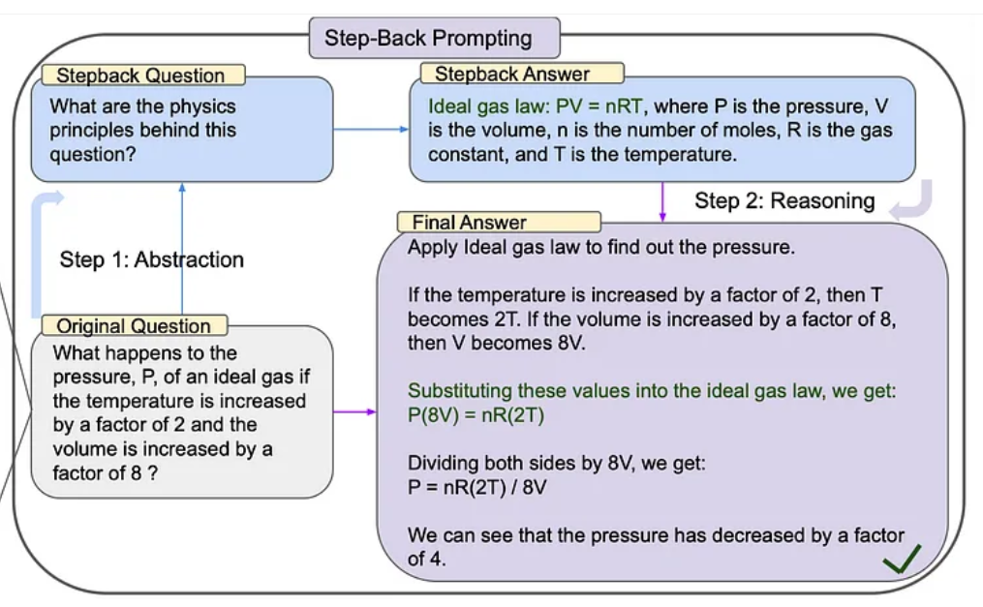

Slide 28
4. Subqueries:
Divide a query into multiple sub-queries and answer them.
Llama Index and Lang chain has support
5. HyDE:
Hypothetical Document Embedding
Generated answers may be closer to the context in the embedding space than a direct query.
Utilizing LLM, HyDE generates a hypothetical document (answer) in response to a query.
Embeds the document and employs this embedding to retrieve real documents similar to the hypothetical one.

Slide 29
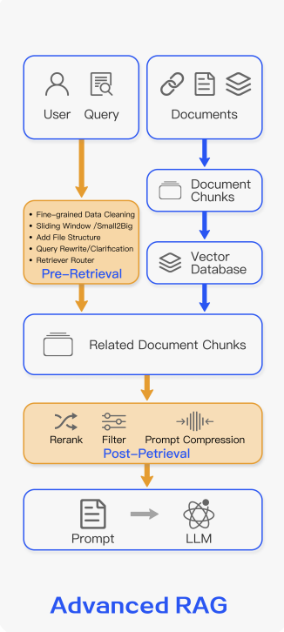

Slide 30
RAG Pipeline Optimization
The optimization of the retrieval process aims to enhance the efficiency and information quality of RAG systems
Hybrid Search:
blending various techniques such as keyword-based search, semantic search, and vector search
Recursive Retrieval and Query Engine:
Recursive retrieval entails acquiring smaller document blocks during the initial retrieval phase to capture key semantic meaning.
In the later stages of this process, larger blocks with more contextual information are provided to the language model (LM).
Step-Back-prompt:
Create a step-back question and answer the original question by answering the step-back question.

Slide 31
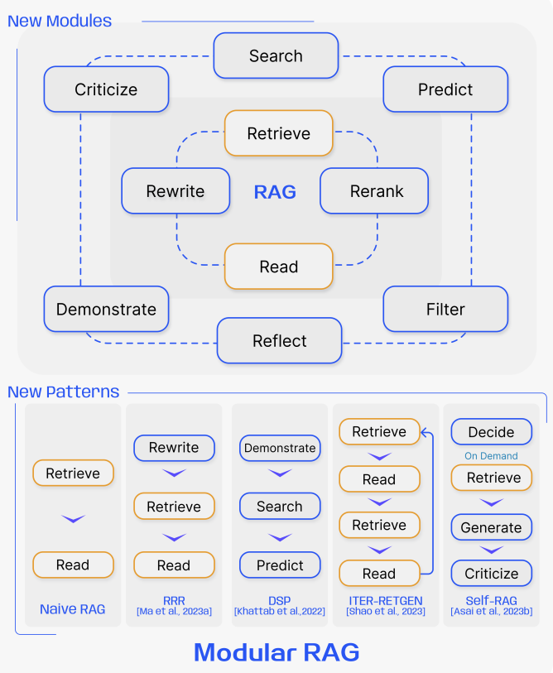

Slide 32
